Slide 2
Info fra Cecilia
Bifogat hittar du GAMMA Homework caset inför din intervju 7/9 med Lukasz Bolikowski via Webex klockan 11-12. Du skickar tillbaka caset till mig senast söndag kväll 2/9.
Förväntningar inför presentationen är att vi vill se ett affärsbeslut grundat i ditt tekniska arbete. Vi vill se både en teknisk utvärdering (e.g. AUROC score) samt en kvantitativ affärsutvärdering (ex ekonomisk effekt) i din presentation.
Kärnan i presentationen ska fortfarande vara teknisk, men den ska "förpackas" av affärsmässiga överväganden. Exempelvis så kan du börja med att ge en övergripande bild av caset och avsluta med en kvantitativ affärsbedömning och ett affärsbeslut/förslag.
Jag finns även tillgänglig på söndag om det skulle vara så att du har några frågor är det bara att du hör av dig till mig!
Önskar dig lycka till!

Slide 3
övergripande bild av caset

Slide 4
Problem statement
Question 1
Question 2

Slide 5
Hypothesis
Hypothesis 1
Hypothesis 2

Slide 6
Conclusion
Conclusion 1
Conclusion 2

Slide 7
Assumptions
Assumption 1
Assumption 2

Slide 8
Key findings
When churning
Key churn drivers

Slide 9
Business Understanding

Slide 10
Technical Understanding
Is it a supervised or unsupervised learning problem?
Supervised
xgboost, regression
Objective function obj(θ)=L(θ)+Ω(θ), where L is training loss function (often set as mean squared error), and Ω is the regularization term (controls the complexity of the model, which helps us to avoid overfitting). We want both to be low, but we will have a bias-variance tradeoff between L and Ω.
Unsupervised: no straightforward way to evaluate the accuracy
Clustering (k-means), help from t-sne etc.
Neural Networks
Classification or regression?

Slide 11
Data Understanding

Slide 12
Data Preparation

Slide 13
Modeling

Slide 14
Model Evaluation
Score etc.
Business value

Slide 15
Concluding remarks / Deployment

Slide 16
Appendix 1
Assumptions:
- Price power: cent per kilowatthour.
- price gas: dollar per THERM.
- gas.usage: Cubic feet of natural gas, Since kwh = 1/3 cubic feet, and 21101 kilowatthours is normal household, and mean = 171249
- Electricity: KWH, Since mean cons: 194804KWH and 10,766 kilowatthours is normal household
Bare sørg for å si at "jeg har gjort denne antakelsen, men i virkeligheten ville det selvsagt vært viktig å bekreftet dette med kunde"... Og gjør en liten sanity check på resultatene

Slide 17
Theory

Slide 18
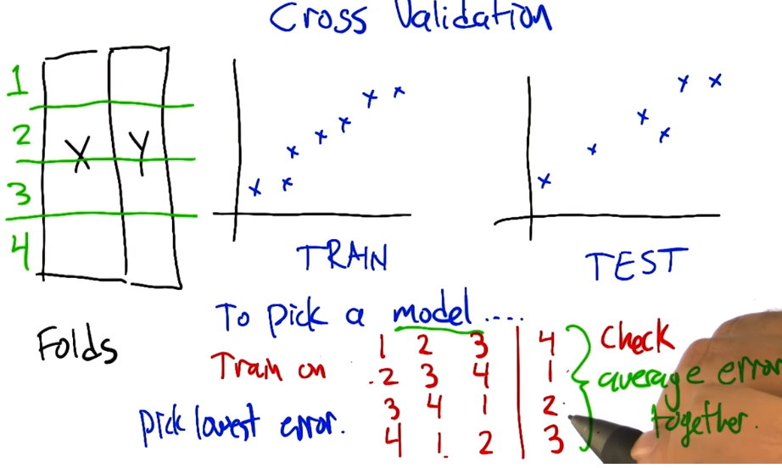
Cross validation
Man tar et "test set" av treningssettet, og validerer på dette settet etter har lagd en modell.
Gjør dette flere ganger har vi k-fold, der vi setter opp k bins. Vi velger så den modellen som ga lavest error.
SÅ tankegangen er "litt" som bagging,, for fortsatt helt forskjellig konsept.
https://www.youtube.com/watch?v=sFO2ff-gTh0.
https://www.youtube.com/watch?v=TIgfjmp-4BA
Brukes å velge modell!
Ada, logistic regression eller xg?
Parametere i modell

Slide 19
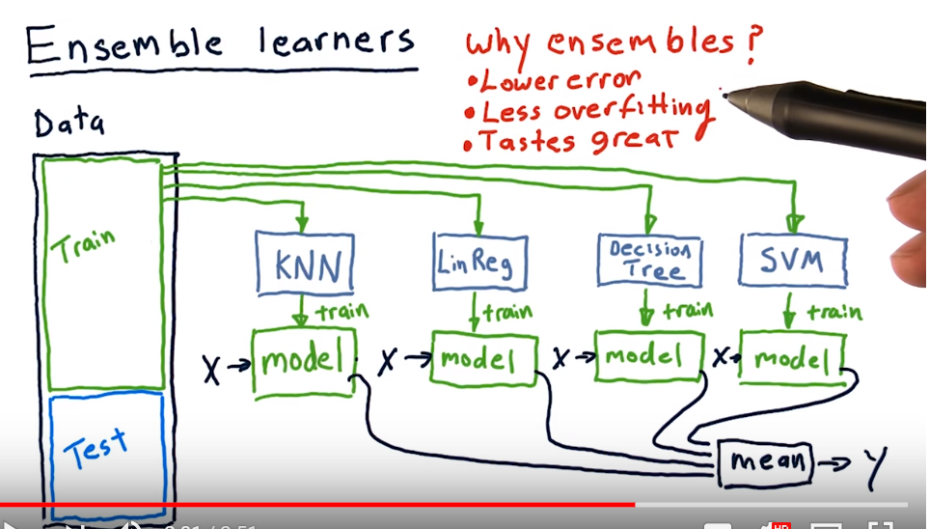
Reduce bias - each model have bias but put together the total goes down
Can plug in and use for kNN, linear regression – what ever → Don’t have to be treemodels!
https://www.youtube.com/watch?v=Un9zObFjBH0

Slide 20
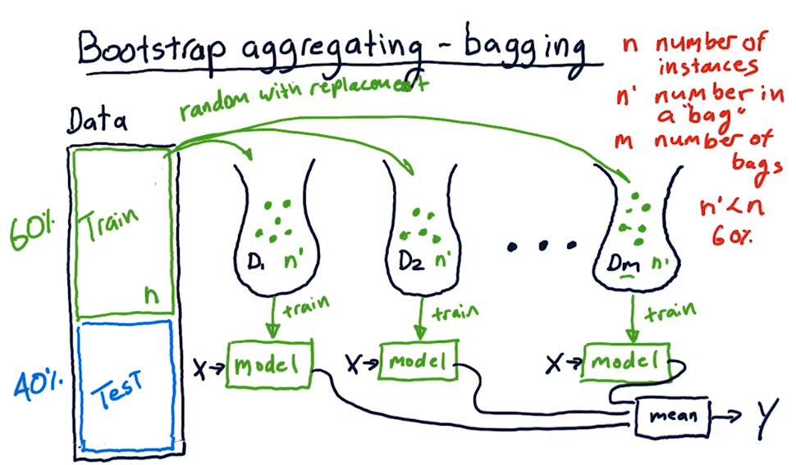
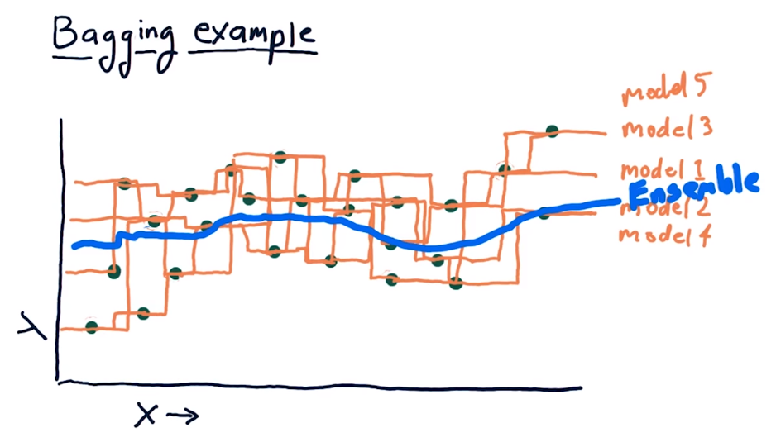
Bagging – boostrap aggregation
A way of building an ensamble learner – use same learning algo, but letting each model do different part of data.
Take a subset n out from training set, randomly with replacement, and make a model.
Then repeat the above m times (m bags)
Then pick the average model and use that à so can be done in parallel!
https://www.youtube.com/watch?v=2Mg8QD0F1dQ

Slide 21
Random Forrest
More or less same as bagging, but take a selection of predictors each time!
Thus it can be done in parallel!
https://www.youtube.com/watch?v=6yICuCnlh5Q
Random forests provide an improvement over bagged trees by way of a small tweak that decorrelates the trees.
As in bagging, we build a number of decision trees on bootstrapped training samples. But when building these decision trees, each time a split in a tree is considered, a random sample of m predictors is chosen as split candidates from the full set of p predictors.
The split is allowed to use only one of those m predictors. A fresh sample of m predictors is taken at each split, and typically we choose m ≈ √p—that
is, the number of predictors considered at each split is approximately equal to the square root of the total number of predictors.

Slide 22
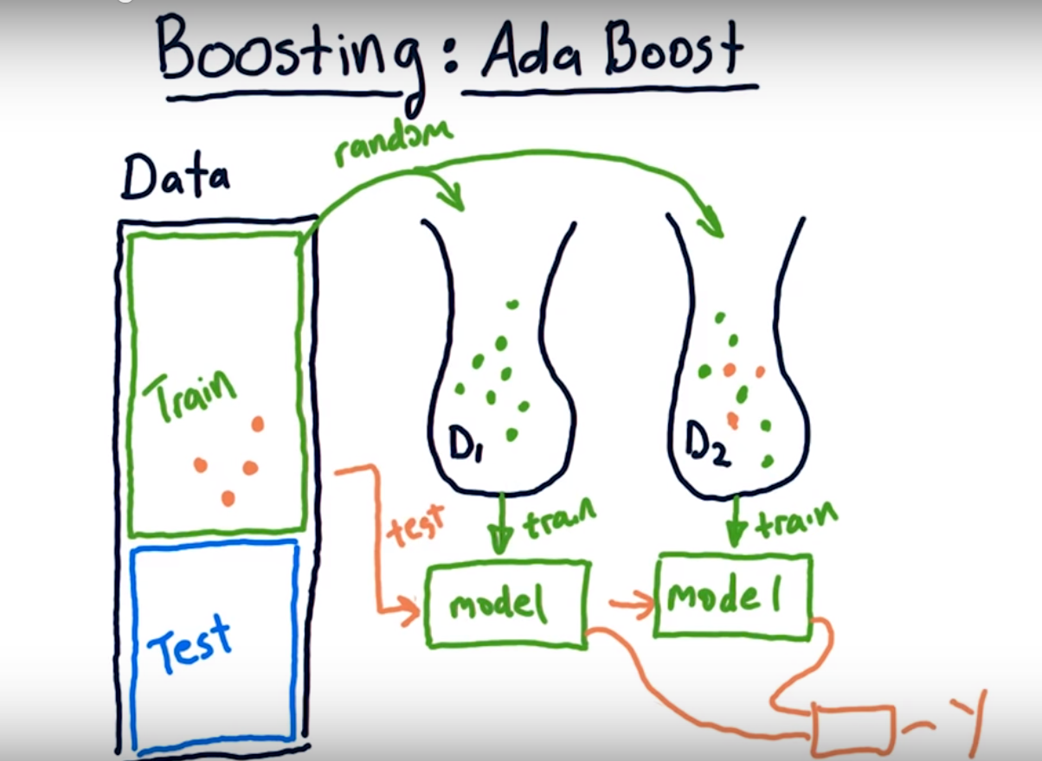
Boosting: Ada (adaptive) Boost (sequential training)
A simple variation on bagging. Strives to improve learners, focusing on areas where learners are not performing well.
Here we don’t do parallel, but letting each learner learn from previous. Instances that had large error in previous learner is more likely to get picked from training data (picking then randomly but weighted) and added to new learner.
Boosting is a method of converting a set of weak learners into strong learners. Suppose we have a binary classification task. A weak learner has an error rate that is slightly lesser than 0.5 in classifying the object, i.e the weak learner is slightly better than deciding from a coin toss. A strong learner has an error rate closer to 0. To convert a weak learner into strong learner, we take a family of weak learners, combine them and vote. This turns this family of weak learners into strong learners.
The drawback of AdaBoost is that it is easily defeated by noisy data, the efficiency of the algorithm is highly affected by outliers as the algorithm tries to fit every point perfectly. You might be wondering since the algorithm tries to fit every point, doesn’t it overfit? No, it does not.
https://www.youtube.com/watch?v=GM3CDQfQ4sw
https://hackernoon.com/boosting-algorithms-adaboost-gradient-boosting-and-xgboost-f74991cad38c

Slide 23
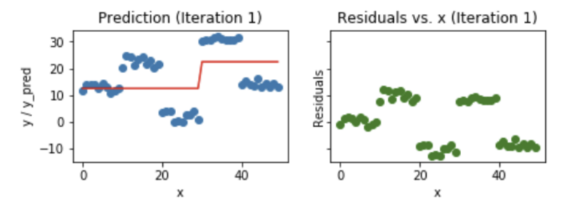
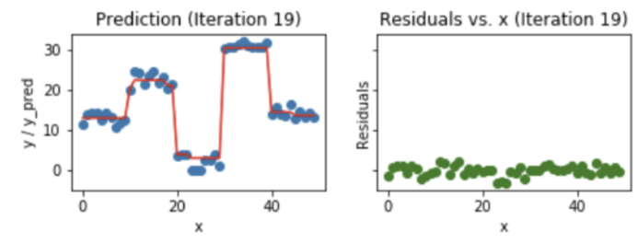
Boosting: Gradient Boost (sequential training, but can parallelize some processes in xgboost)
Same concept as AdaBoost (convert a set of weak learners into a single strong learner).
Ada and Gradient differ on how they create the weak learners during the iterative process.
Gradient boosting + xgboost: https://hackernoon.com/gradient-boosting-and-xgboost-90862daa6c77
Parallell in xgboost: http://zhanpengfang.github.io/418home.html
Xgboost doesn't run multiple trees in parallel like you noted, you need predictions after each tree to update gradients.
Rather it does the parallelization WITHIN a single tree my using openMP to create branches independently.
At each step, we add another weak learner to increase the performance and build a strong learner. This reduces the loss of the loss function. We iteratively add each model and compute the loss. The loss represents the error residuals(the difference between actual value and predicted value) and using this loss value the predictions are updated to minimise the residuals.

Slide 24
Boosting: Ada vs Gradient boost
Ada(ptive): Voting in wrongly predicted instances
At each iteration, adaptive boosting changes the sample distribution by modifying the weights attached to each of the instances. It increases the weights of the wrongly predicted instances and decreases the ones of the correctly predicted instances. The weak learner thus focuses more on the difficult instances. After being trained, the weak learner is added to the strong one according to his performance (so-called alpha weight). The higher it performs, the more it contributes to the strong learner.
Gradient: optimization problem
Gradient boosting doesn’t modify the sample distribution. Instead of training on a newly sample distribution, the weak learner trains on the remaining errors (so-called pseudo-residuals) of the strong learner. It is another way to give more importance to the difficult instances. At each iteration, the pseudo-residuals are computed and a weak learner is fitted to these pseudo-residuals. Then, the contribution of the weak learner (so-called multiplier) to the strong one isn’t computed according to his performance on the newly distribution sample but using a gradient descent optimization process. The computed contribution is the one minimizing the overall error of the strong learner.

Slide 25
Boosting: XGBoost (extreme gradient boost)
XGBoost is similar to gradient boosting algorithm but it has a few tricks up its sleeve which makes it stand out from the rest.
Clever Penalisation of Trees
A Proportional shrinking of leaf nodes
Newton Boosting
Extra Randomisation Parameter
In XGBoost the trees can have a varying number of terminal nodes and left weights of the trees that are calculated with less evidence is shrunk more heavily. Newton Boosting uses Newton-Raphson method of approximations which provides a direct route to the minima than gradient descent. The extra randomisation parameter can be used to reduce the correlation between the trees, as seen in the previous article, the lesser the correlation among classifiers, the better our ensemble of classifiers will turn out. Generally, XGBoost is faster than gradient boosting but gradient boosting has a wide range of application
https://hackernoon.com/gradient-boosting-and-xgboost-90862daa6c77
Params:
Key:
eval_metric
Cv - related
Tree boster params
Eta (aka learning rate: step size shrinkage used in update to prevent overfitting)
Gamma : Minimum loss reduction required to make a further partition on a leaf node of the tree. The larger gamma is, the more conservative the algorithm will be.
max depth: Maximum depth of a tree. Increasing this value will make the model more complex and more likely to overfit. 0 indicates no limit
min child weight: Minimum sum of instance weight (hessian) needed in a child. The larger min_child_weight is, the more conservative the algorithm will be.
scale_pos_weight (if imbalanced and sufficient data)
See:
https://xgboost.readthedocs.io/en/latest/parameter.html
https://www.analyticsvidhya.com/blog/2016/03/complete-guide-parameter-tuning-xgboost-with-codes-python/

Slide 26
Theory of tree models
Now here comes a trick question: what is the model used in random forests? Tree ensembles! So random forests and boosted trees are really the same models; the difference arises from how we train them.
This means that, if you write a predictive service for tree ensembles, you only need to write one and it should work for both random forests and gradient boosted trees.
Additive training (boosting):
we use an additive strategy: fix what we have learned, and add one new tree at a time.
Random forest and pure bagging we can do in parallel – no interference
Learn the tree structure with boosting
We could enumerate all possible trees and pick the best one. But not possible, so in boosting we will try to optimize one level of the tree at a time. Specifically we try to split a leaf into two leaves, and score it agains a gain function. This is exactly the pruning techniques in tree based models!

Slide 27
Neural Networks
https://www.youtube.com/watch?v=aircAruvnKk
They use gradient decent for learning
Can get stuck in local minima of course. But can solve by vary step size and starting point… However we will never be sure we get a global minima (have to do exhaustive computing)
Use backpropagation
Has continuously activity levels (most often I guess)
Usage
Image and speech recognition
Does it make sense for typical customer analytics at all?
Very very black box
Supervised learning (but can also do unsupervised?)

Slide 28
Logistic regression
Logistic regression predicts if something is true or false
Fitting a s-shaped function
xx

